Slide 1
CS5551 – Advanced Software Engineering Speech Helper/Pronunciation Helper
By
Geetalakshmi Javvadi
Jinal Patel
Supraja Raghavan

Slide 2
Motivation
Globalization has made it possible for people from different parts of the world to interact amongst each other.
English is the international language for cross culture communication. English is the most common language.
Most of the universities around the world offer courses only in English. Good job opportunities require fluent English accent.
Every ethnic group is influenced by the accent of their native language and it becomes difficult to change the accent when they speak in English.
Since the people who speak other languages are influenced by the stress on syllables according to their native language it impacts their accent in English.
Speech recognition and accent or pronunciation correction is the main idea of our project.

Slide 3
Objectives
The Speech/Pronunciation Helper Application plays a significant role in the correction of accent for non-native speakers in English.
People from different native languages face problems in communication as accent of their native language always dominates the pronunciation of their secondary language.
This has motivated us in taking up this project which would assist non-native speakers in achieving their language goals efficiently.
Our objective is to facilitate the non-native speakers of the English Language to change their accent in speaking certain English words.
This would help improve their pronunciation and would enhance their communication.

Slide 4
Our Approach
For our project we are following the Service Oriented Architecture (SOA) and the Agile Development Process.
We use the incremental and iterative methodology that uses object oriented programming to develop our software system and to keep track of the project development and progress.
It also gives us the possibility to make changes to the initial scope of our project. Agile process gives us more flexibility in with the development and testing framework
We divide the system into various components and tasks, and analyze the structure of the workflow for these tasks. This enables us to modify and improve the various tasks assigned for the iterations.
The different components that we use are the IBM cloud Instance, web services, Sql server database and an android client

Slide 5
Features
Functional:
System allows the user to register.
User can log in into the system.
User is allowed to choose the group..
System will show the list of words and the accent that is followed.
User can practice as many times as wanted.
Non functional:
System is easy to use if the user has a login Id.
Software tool will be available and accessible almost all the time.
The administrator of the system is allowed to add more details to the existing tool to make more tutorials accessible for the user. The software is scalable and can be extended as required.
The software tool is usable only by authenticated users; unauthenticated people cannot login into the system to use the tool.

Slide 6
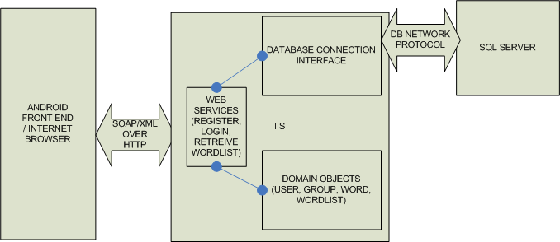
System Architecture

Slide 7
Technological requirements
Languages: ASP.net, C#, Java, HTML, JQuery and JavaScript
Front End: .NET framework; Android development framework, Phonegap.
Back End: On the IBM cloud we have the IIS Server, Microsoft SQl Server installed on the cloud instance
Operating Systems: Microsoft Windows.
Protocols: HTTP, SOAP and WSDL.
Testing: Nunit Testing.
Project Management: Agilefant, GitHub and SkyDrive

Slide 8
Implementation – Web Services
We created the Web Services for Registration, Login and Group Selection.
Registration
In this web service the user registers for access to the accent mobile application.
They provide the required details such as the
username,
password,
name and
email address.
The users are thus registered to the system after which they can login to the system.

Slide 9
Implementation Contd
Login:
After a user has registered for access to the mobile application, the user is authenticated and verified.
If the user enters an authentic username and password he is allowed access to the application.
The user needs to Login to the application in order to access their group and the word list for their accent group

Slide 10
Implementation Contd
Group Selection:
The web service that we created is used to allow the user to select his/her desired group.
The users of our application need to specify a group to which he/she would have access to.
The users can select from various groups such as Chinese, Japanese and Indian.
After a user has registered and logged in to the mobile application, the user can access his/her group.
This group contains the list of words for which the user would like to learn the accent for.
When the user selects a word, the accent audio of the word can be played as many times as the user wants.
Thus the user can listen to the words as many times as wanted to practice the correct accent of the word.

Slide 11
Demo

Slide 12
Implementation Contd
Android Implementation
The speech/pronunciation helper application, is an android application.
We designed, developed and implemented the android accent application.
We created the User interface and connect to the web service that gives the details of the group through HTML5.
From which the user can select the words to play the audio of the word for which they need the accent for.
We used Phonegap to integrate Android media player to HTML5 pages.
We used the Android simulator and an Android Smart phone to run our applications.

Slide 13
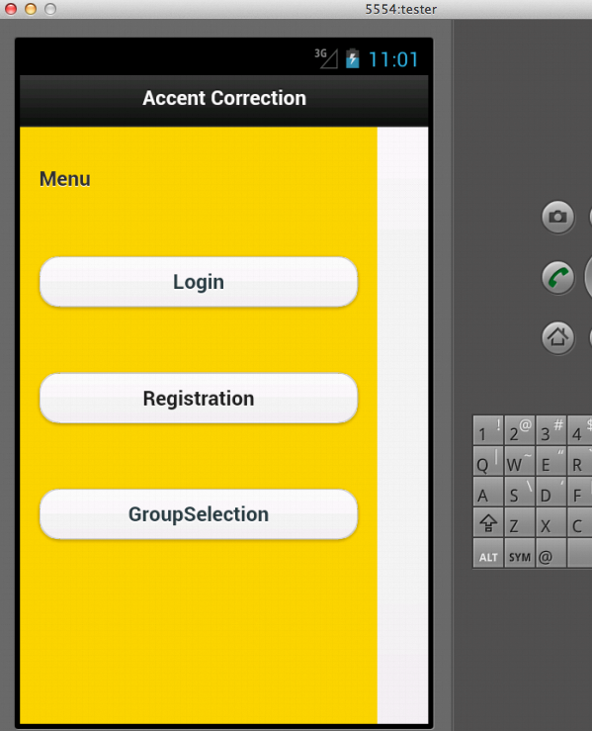

Slide 14
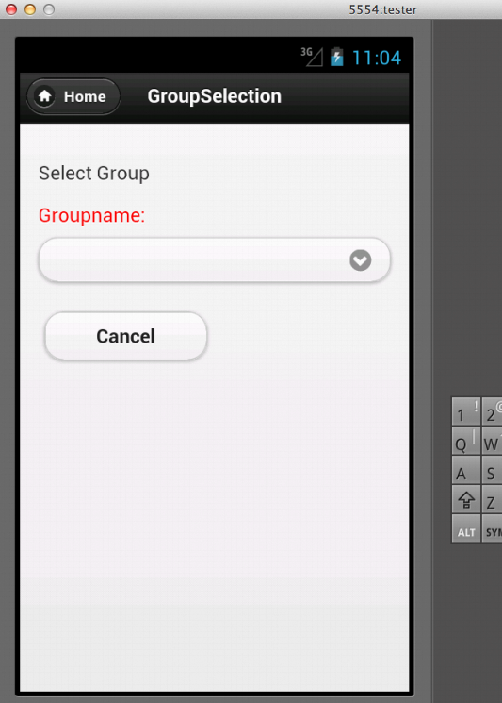

Slide 15
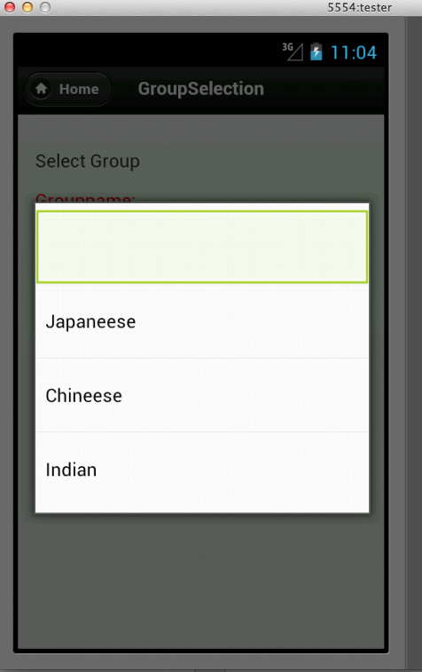

Slide 16
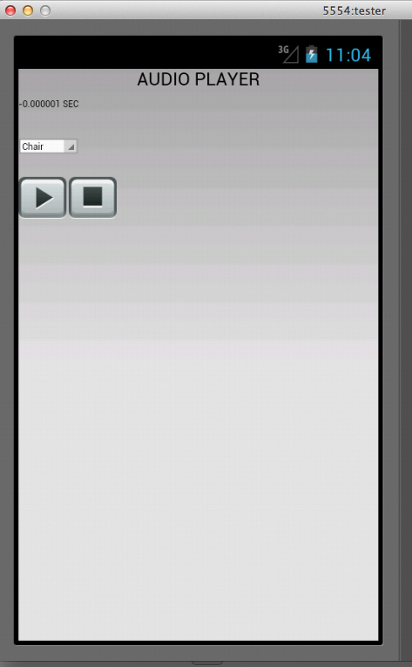

Slide 17
Demo

Slide 18
Evaluation
Significance
The significant part of this tool is the accent correction which would enable the proper pronunciation of words and there by make them more confident and comfortable while presenting their ideas and would also favor the listener in understanding the language easily.
One of the fascinating aspects of this tool is that it can be used by people of all ages, without any assistance from anyone as it is very simple to operate.
Limitations:
This is an android based application and hence is not compatible with other mobile operating systems.
Due to time and instance availability, we have developed and implemented the basic features of our application.
Future Work:
We can allow the user to evaluate his own performance. The user can listen to the pronunciation. She/he can then record their own pronunciation and save their audio. She/he can record his audio over a period of several weeks. She/he could then judge their own performance based on the comparison between these audios.

Slide 19
Acknowledgments
We Thank Dr.Lee, Saurav Jana and Nancy for their guidance and information.
We would like to thank for the support given by the IBM Smart Cloud Enterprise program.

Slide 20
Thank You !

